Slide 1
Presentation to
Moody’s Investors Service
September 8, 2026

Slide 2
Agenda
Economy and Tax Base
2026 Debt Issuance
Overview of City Finances
Litigation and Risk Management

Slide 3
Economy and Tax Base

Slide 4
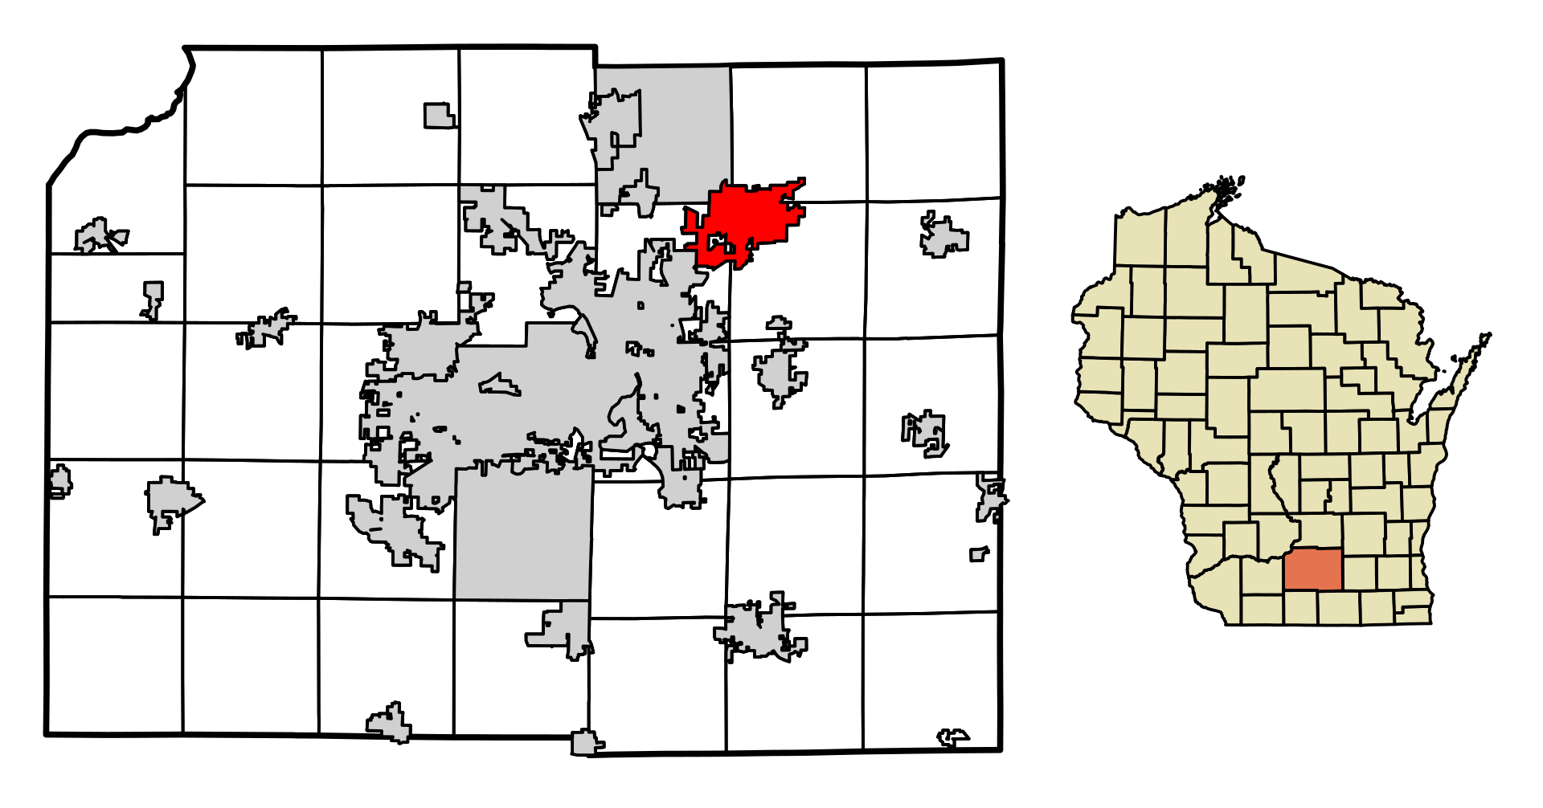
Community Background
Located in Dane County (AAA), adjacent to the City of Madison (Aaa)
Approximately 13.1 square miles
One of the fastest growing cities in Wisconsin
Population estimate of 40,079
January 1, 2025 Equalized Value of $6,473,743,000 (TID in)

Slide 5
Economic Advantages
Highly Desirable Dane County Location
  10 miles to the Dane County Regional Airport
  155 miles to Chicago
  75 miles to Milwaukee
  255 miles to the Twin Cities
  I-90, I-94, and STH 151 provide convenient access
  University of Wisconsin- Madison
  Local and express bus service
    Bus Rapid Transit was implemented in 2024
  Sun Prairie Area School District
Unemployment Rate (as of June ’26)
  City of Sun Prairie: 2.7%
  State of Wisconsin: 3.3%
  United States 4.1%
  Per Capita AGI (2025)
  City of Sun Prairie $45,241
  Dane County $49,532
  State of Wisconsin $41,124

Slide 6
Largest Employers
Many major employers have undergone recent physical expansions or renovations due to growing needs of City
All of the 10 largest employers are stable or expanding
Sun Prairie School District projects increase in student enrollment
Rank | Employer | Employees
1 | Sun Prairie School District | 1,501
2 | City of Sun Prairie | 992
3 | Colony Brands | 505
4 | Costco | 419
5 | Wisconsin Distribution | 412
6 | Axim Geospatial | 360
7 | Prairie Athletic Club | 300
8 | Trachte Building Systems Inc. | 291
9 | Target | 274
10 | Royle Printing | 273

Slide 7
Largest Taxpayers
9 out of the 10 taxpayers are stable or expanding.
Taxpayer | Type of Property/Business | 2025 Assessed Value
Fedler Connery | Apartments | $165,073,600
Weidner Apartments | Apartments | $65,404,800
Prairie Lakes Retail | Retail | $53,963,100
Park 151 | Business Park | $53,685,300
Gebhardt Property | Housing | $43,496,500
Continental 345 Fund | Housing | $42,988,700
SSM Health | Healthcare | $37,988,900
CR Creekside LLC | Housing | $37,871,900
Ryan Great Lakes SP LLC | Apartments | $33,761,100
Menards | Box Store | $28,550,300

Slide 8
Historical Population Growth
Population increased 23% between 2016 and 2025
Average annual population increase since 2016 has been 746
Annual population growth of 700-1,000 persons per year projected
State of WI 2030 estimated population of 41,143
  If current trend continues, we estimate a 2030 population of 43,500 to 44,500

Slide 9
Historical Tax Base Growth
Equalized value increased 134% between 2016 and 2025
$2.772 billion to $6.474 billion
City of Sun Prairie's Equalized Value

Slide 10
Equalized Value by Property Class (2025)

Slide 11
Tax Base Growth
Projected growth in Equalized Value of 5.61% annually (4.2% economic change and 1.41% net new construction)
Residential values increased $300 million (7.6%) from 2024 to 2025
Commercial improved new construction increased $91 million (4.49%) from 2024 to 2025

Slide 12
Tax Base Growth, Projected Development
Construction of a full-service hotel with completion date of 2026
New medical facility opened in 2025 adding $50M in new value
Downtown redevelopment expected to add $34M in new value by 2027
Manufacturing growth expected
  165,000/sf facility expected to pull permit by end of 2025
  45 acres will begin site development and infrastructure installation for future growth. As of 1/1/2026 this will add $4.5M in new value.

Slide 13
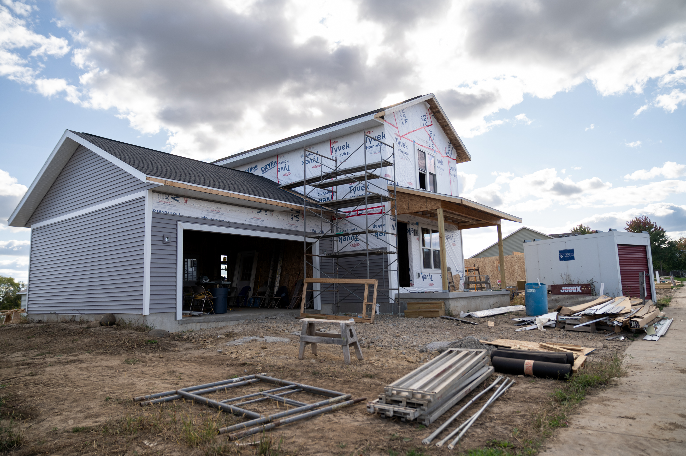
Current Market Trends
Single Family homes in last 12-months:
  389 sales
  Average sale price $498,489
  Average days on the market was 34
Condos in last 12-months:
  114 sales
  Average sale price $310,560
  Average days on the market was 21

Slide 14
Building Permit Trends
2026 permit are on trend to meet or exceed 2025 numbers.
 | 2022 | 2023 | 2024 | 2025 | 2026 (as of June 30th)
New Single-Family Homes/Duplexes
# of Permits | 100 | 92 | 80 | 94 | 56
Valuation ($) | 37,442,365 | 38,929,712 | 35,459,634 | 45,240,713 | 28,200,750
New Multiple Family Homes
# of Permits | 30 | 36 | 5 | 0 | 0
Valuation ($) | 75,101,056 | 71,652,598 | 37,300,000 | 0 | 0
New Commercial / Industrial
# of Permits | 12 | 7 | 7 | 7 | 7
Valuation ($) | 41,984,109 | 15,991,422 | 78,921,935 | 67,191,011 | 10,908,463
All Building Permits
# of Permits | 2,915 | 2,807 | 2,984 | 2,896 | 1,877
Valuation ($) | 212,312,792 | 183,020,683 | 289,563,513 | 167,776,179 | 81,208,441

Slide 15
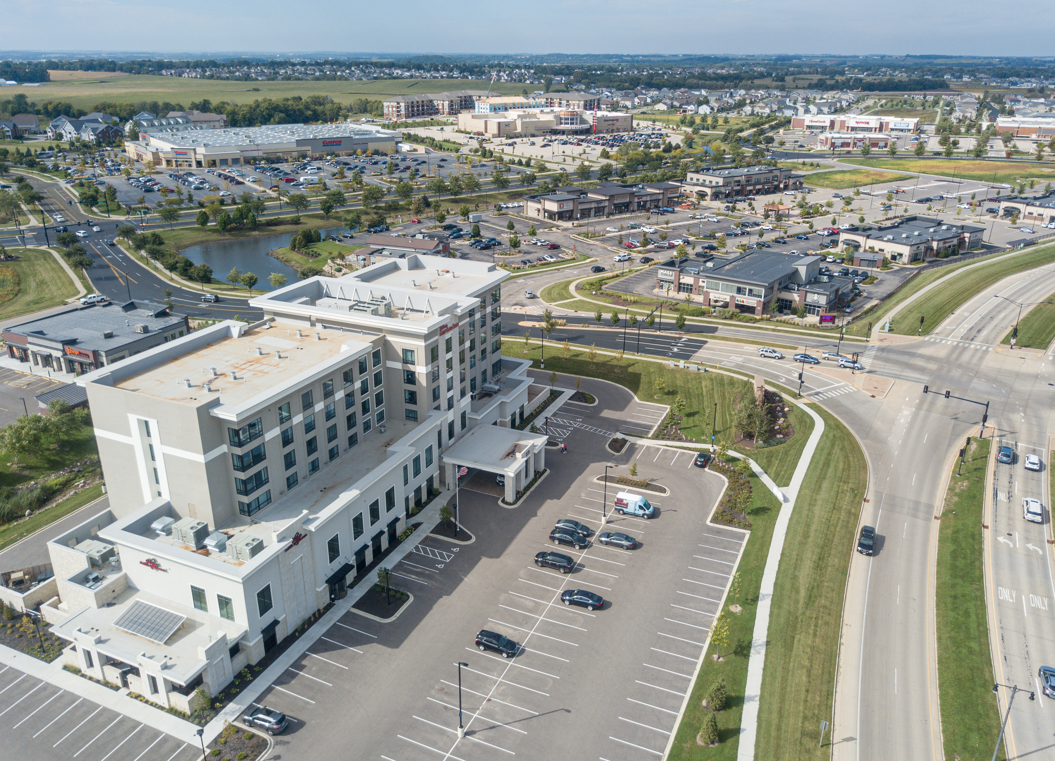
Tax Increment Financing Districts
TID 8 – Downtown
  Final increment received in 2026
  Final TID closure documents submitted to DOR
  TID full value will be added back to 2026 tax roll
TID 9 – Westside Commercial
  Final increment received in 2026
  Final TID closure documents submitted to DOR
  TID full value will be added back to 2026 tax roll

Slide 16
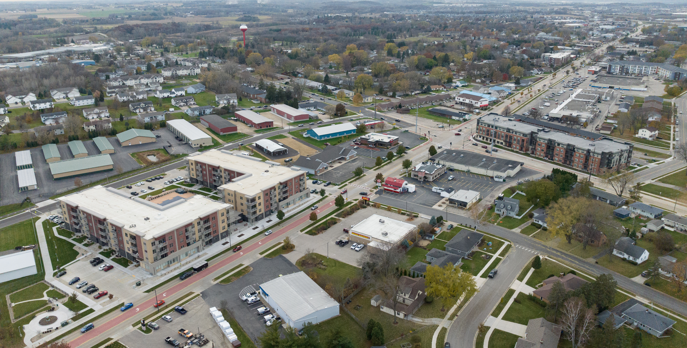
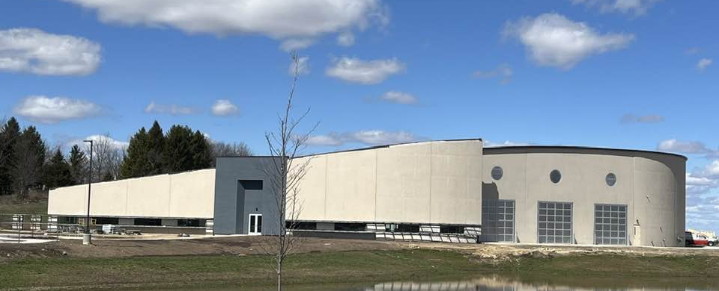
Tax Increment Financing Districts (cont.)
TID 11 – Central Main Street Corridor
  Public pedestrian improvements
  Increased infrastructure for bus stops along corridor
TID 12 – SP Business Park, 6th Addition
  Review for future development and infrastructure needs
  Finalized sale of City owned land $806,000 to Yahara Materials
    Yahara Materials will begin site development, which will include bedrock extraction in preparation for several flex industrial buildings
    Significant increase in land value once development starts

Slide 17
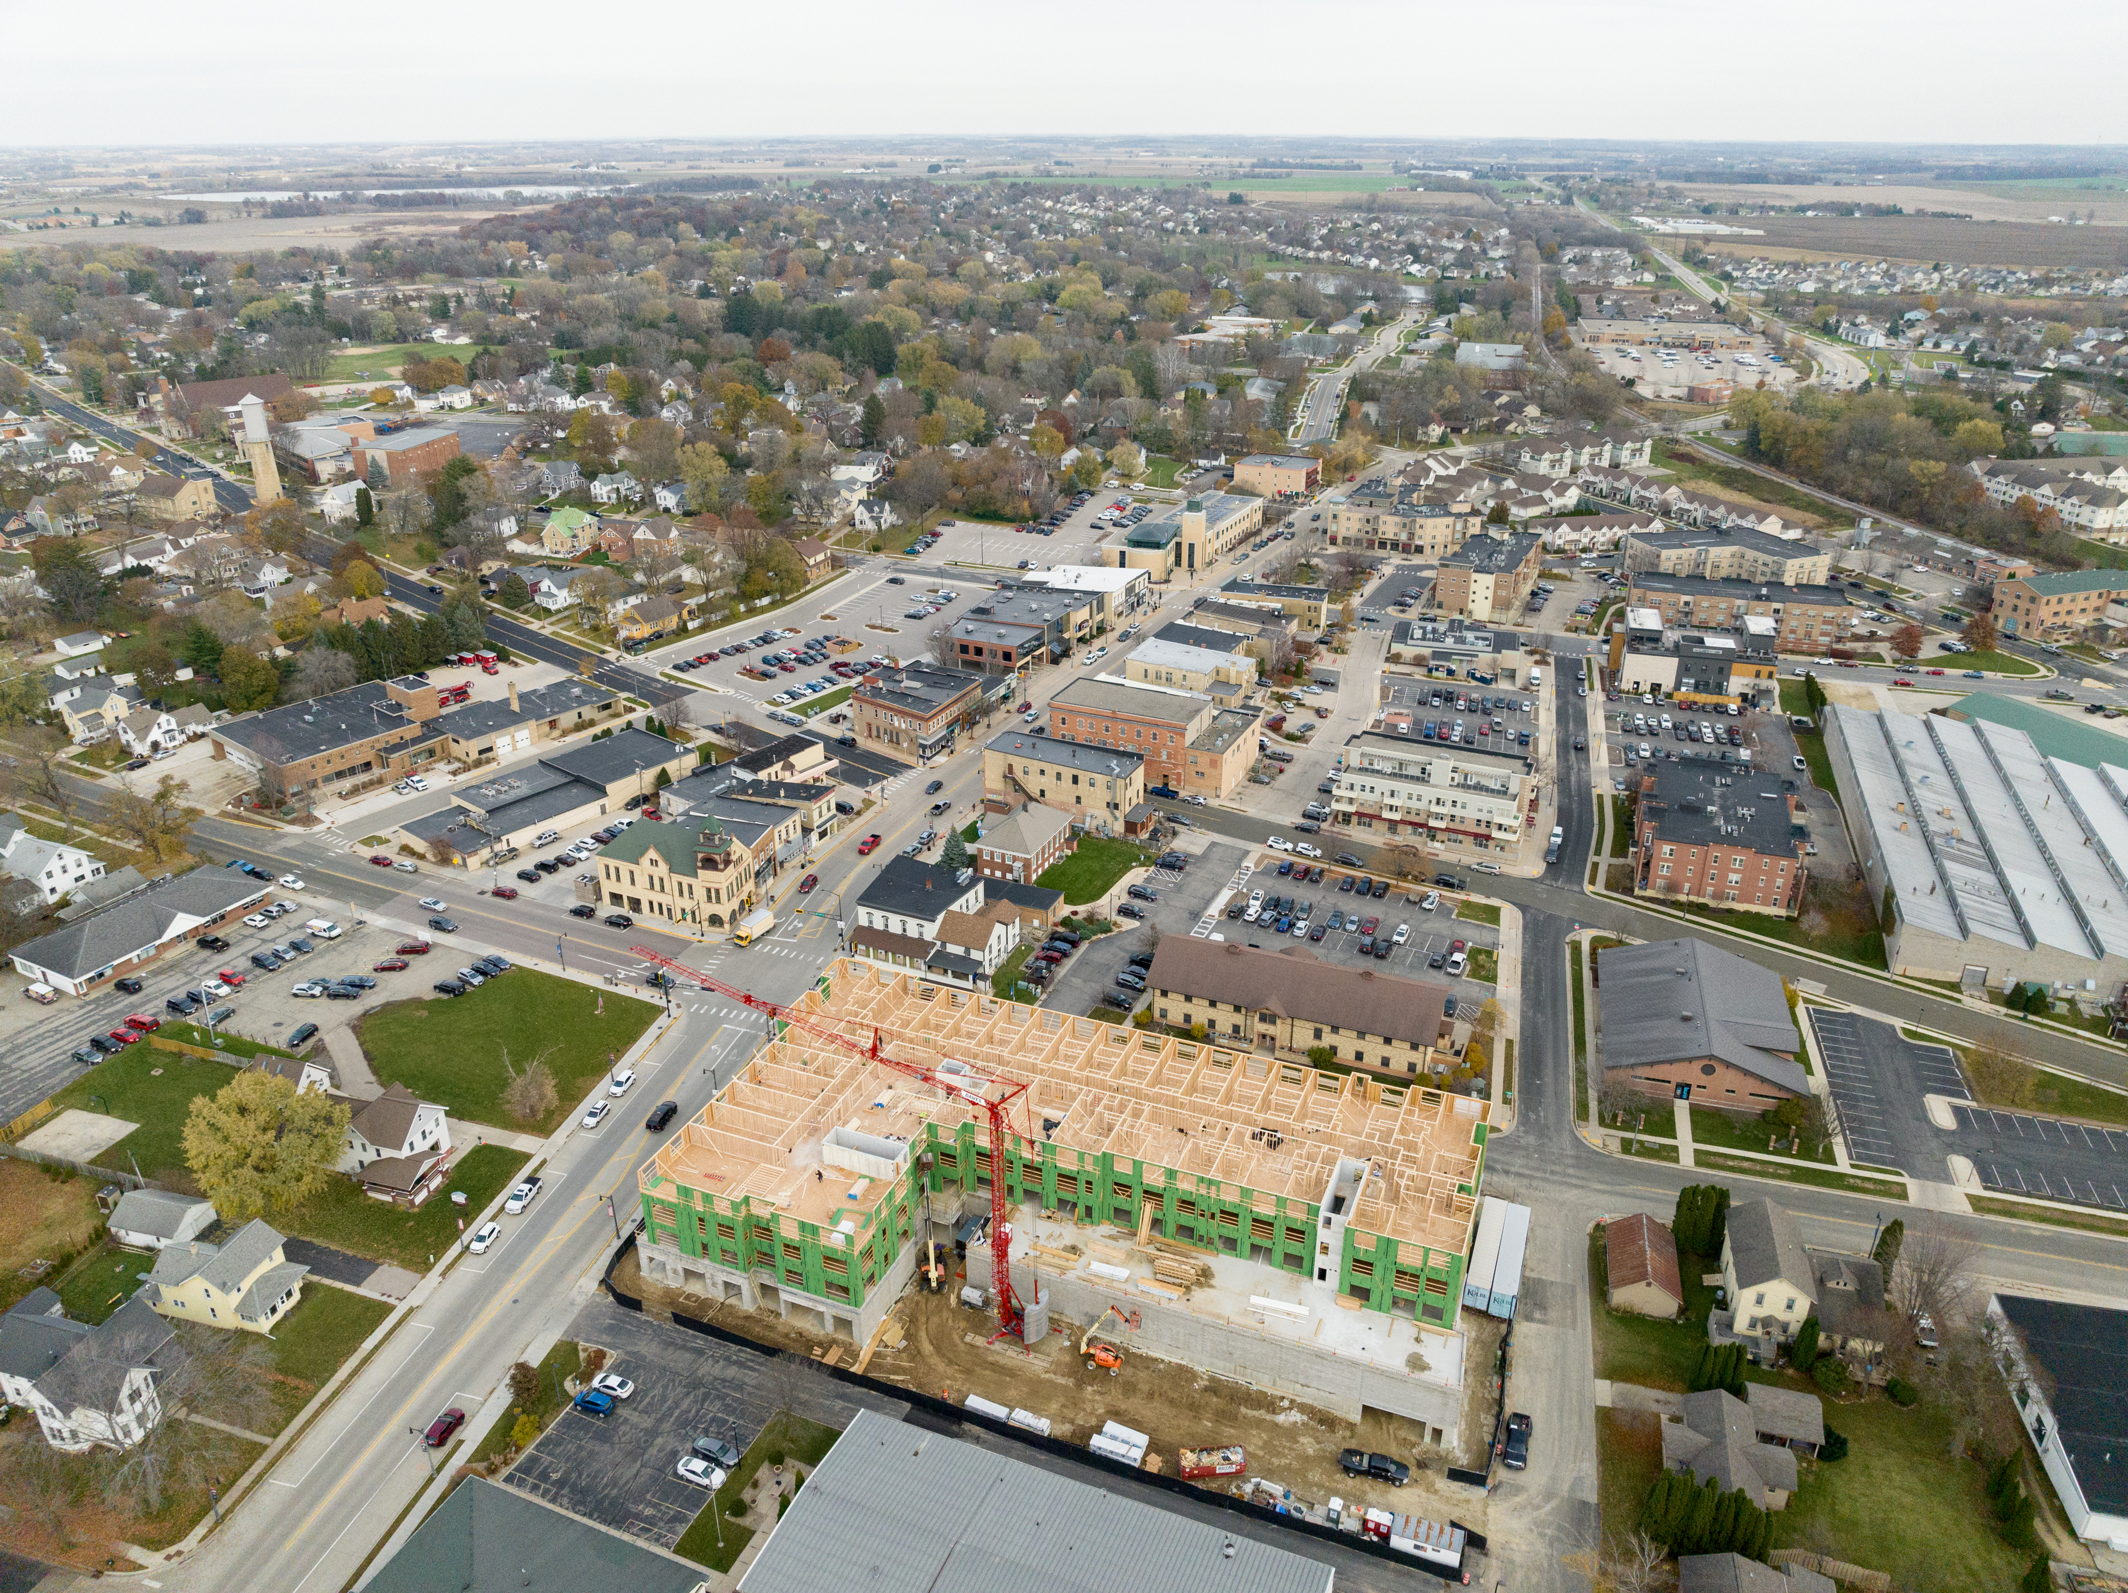
Tax Increment Financing Districts (cont.)
TID 13 – Park 151 Business Park
  Park is completely built out
  Final incentive paid out in 2025
  Anticipate approval of one-year extension for affordable housing with closure in 2029
TID 14 – Downtown, SP Stronger
  Construction began at NW corner of Bristol & Main for 63-room hotel with restaurant
  All commercial property fully leased and built out at SW corner of Bristol & Main
  Updated zoning approvals for 100-unit building starting later this year

Slide 18
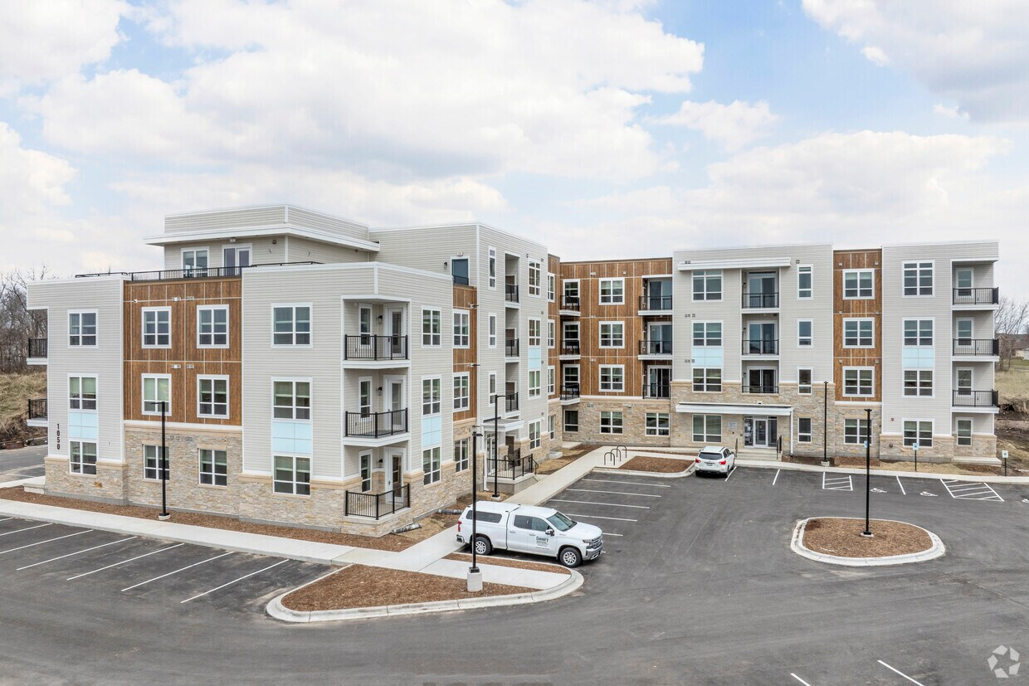
Tax Increment Financing Districts (cont.)
TID 15 – West Main Street
  Increased infrastructure for bus stops along corridor
TID 16 – East Main Development
  1/1/2023 creation date
  No new development items

Slide 19
2026 Debt Issuance

Slide 20
2026A Series A GO Notes
10-Year Notes
Approximately $12,025,000 inclusive of debt issuance costs
  $7,370,364 in street reconstruction, rehabilitation and multi-modal costs
  $1,090,000 in city facility project costs
  $332,500 in park improvement costs
  $2,334,720 in fleet replacement costs
  $451,838 in equipment replacement costs
  $160,000 in stormwater project costs
  $285,578 in debt issuance costs less interest earnings

Slide 21
2026 Financing Plan
 |  |  |  | General / Cap Projects |  |  | Wastewater |  | Storm Water |  | Sun Prairie Utilities |  | Total Borrowing
PROJECT |  | YEAR | TOTAL | General/ | Prior Note | Grant |  | Prior | STORM | Prior |  | Retained | Gen. Ob.
 |  |  | PROJ. BUDGET | Cap Projects | Funds | Funds | WWTP | Bond Funds |  | Bond Funds | SPU | Earnings | Notes
Street Reconstruction
000003 - Borings for Future Years | Streets | 2026 | 25,000 | 25,000 |  |  |  |  |  |  |  |  | 25,000
000005 - Concrete Road Repair | Streets | 2026 | 100,000 | 100,000 |  |  |  |  |  |  |  |  | 100,000
000001 - Street Tree Replacement | Streets | 2026 | 30,000 | 30,000 |  |  |  |  |  |  |  |  | 30,000
246024 - Coral Drive/Emerald Terrace Reconstruction | Streets | 2026 | 2,944,943 | 2,245,302 |  | (658,500) | 32,000 | (32,000) | 420,126 | (420,126) | 247,515 | (247,515) | 1,586,802
266022 - HWY 19/Westmount Roundabout | Streets | 2026 | 3,523,000 | 3,425,000 |  | (2,875,000) |  |  |  |  | 98,000 | (98,000) | 550,000
246022 - Montana/Walmart Reconstruction | Streets | 2026 | 1,282,586 | 963,348 |  | (974,653) | 15,160 | (15,160) | 266,578 | (266,578) | 37,500 | (37,500) | 963,348
246004 - Downtown E Main Pedestrian Safety Improvements | Streets | 2026 | 2,369,369 | 2,181,829 |  |  | 7,040 | (7,040) | 170,000 | (170,000) | 10,500 | (10,500) | 2,181,829
266003 - Vernig Road | Streets | 2026 | 265,000 | 265,000 |  |  |  |  |  |  |  |  | 265,000
256049 - Huntington/Sapphire/Colony/Talon Rustic Pavement Rehab. | Pavement Rehabilitation | 2026 | 962,481 | 877,561 |  |  | 41,800 | (41,800) | 20,020 | (20,020) | 23,100 | (23,100) | 877,561
236056 - O'Keeffe/McCoy Intersection Improvements | Traffic Improvement | 2026 | 647,764 | 647,764 |  |  |  |  |  |  |  |  | 647,764
000004 - Vision Zero Safety Improvements | Multi Modal | 2026 | 108,000 | 108,000 |  |  |  |  |  |  |  |  | 108,000
000006 - Annual Multimodal Maintenance/Improvements | Multi Modal | 2026 | 108,000 | 108,000 | (108,000) |  |  |  |  |  |  |  | -
266001 - W. Main St Sidewalk-Thompson Rd to USH 151 | Multi Modal | 2026 | 35,060 | 35,060 |  |  |  |  |  |  |  |  | 35,060
City Facility Projects
261301 - Heated Storage for Public Works Storage Facility | Buildings & Grounds | 2026 | 1,000,000 | 500,000 |  |  |  |  | 500,000 |  |  |  | 1,000,000
261601 - EMS/Fire Station 1 Concrete Entrance | Buildings & Grounds | 2026 | 30,000 | 30,000 |  |  |  |  |  |  |  |  | 30,000
261102 - City Hall Building Signage | Buildings & Grounds | 2026 | 25,000 | 25,000 |  |  |  |  |  |  |  |  | 25,000
261201 - WCSB Make Up Air Unit Replacement & Roof Access Improve. | Buildings & Grounds | 2026 | 35,000 | 35,000 |  |  |  |  |  |  |  |  | 35,000
Park Improvements
254008 - 9-Hole Disc Golf Course | Park Improvements | 2026 | 30,000 | 30,000 |  | (30,000) |  |  |  |  |  |  | -
254012 - Colorado Commons Park East Development | Park Improvements | 2026 | 250,000 | 250,000 | (250,000) |  |  |  |  |  |  |  | -
264007 - Evergreen Park Rehabiliation | Park Improvements | 2026 | 150,000 | 150,000 |  |  |  |  |  |  |  |  | 150,000
264009 - Oakridge Park Rehabilitation & ADA Compliance | Park Improvements | 2026 | 140,000 | 140,000 |  |  |  |  |  |  |  |  | 140,000
264012 - Resurface Pickleball Courts 1-6 at Wyndham Hills | Park Improvements | 2026 | 42,500 | 42,500 |  |  |  |  |  |  |  |  | 42,500

Slide 22
2026 Financing Plan (cont.)
Fleet Purchases
267105 - Engineering Pickup - Replace vehicle 408 | Engineering | 2026 | 70,900 | 70,900 |  |  |  |  |  |  |  |  | 70,900
267301 - Public Works Patrol Truck - Replace Vehicle 126 | Public Works Equip | 2026 | 265,200 | 265,200 |  |  |  |  |  |  |  |  | 265,200
267303 - Public Works Traffic Engineering Van Replace Vehicle 186 | Public Works Equip | 2026 | 90,120 | 90,120 |  |  |  |  |  |  |  |  | 90,120
000000 - Mower | Parks Equipment | 2026 | 68,900 | 68,900 |  |  |  |  |  |  |  |  | 68,900
267304 - Public Works Patrol Truck - Replace Vehicle 125 | Public Works Equip | 2026 | 265,200 | 265,200 |  |  |  |  |  |  |  |  | 265,200
267601 - Fire Department SUV - Replace Vehicle C-4 | Fire | 2026 | 74,400 | 74,400 |  |  |  |  |  |  |  |  | 74,400
267602 - Fire Department - Unit E-8 NEDFU Truck | Fire | 2026 | 1,500,000 | 1,500,000 |  |  |  |  |  |  |  |  | 1,500,000
267305 - Public Works Tandem Axle Hook Truck | Public Works Equip | 2026 | 308,000 |  |  |  |  |  | 308,000 | (308,000) |  |  | -
Equipment
261402 - Fleet Facility Drive on Parallelogram Hoise | Fleet | 2026 | 222,000 | 222,000 |  |  |  |  |  |  |  |  | 222,000
261403 - Fleet Maintenance Facility Alignment Rack Hoise | Fleet | 2026 | 47,000 | 47,000 |  |  |  |  |  |  |  |  | 47,000
262001 - Police Department Dispatch Console Replacement | Police | 2026 | 51,838 | 51,838 |  |  |  |  |  |  |  |  | 51,838
262002 - EMS/Fire Station 1 Washing Machines | Fire/EMS | 2026 | 31,000 | 31,000 |  |  |  |  |  |  |  |  | 31,000
262003 - EMS/Fire Station 1 Generator Replacement | Fire/EMS | 2026 | 100,000 | 100,000 |  |  |  |  |  |  |  |  | 100,000
Wastewater Projects
268101 - Replace Collection System Pickup Truck #617 | Wastewater | 2026 | 140,000 |  |  |  | 140,000 |  |  |  |  | (140,000) | -
Stormwater Projects
000002 - TMDL - Water Quality Projects | Stormwater Equipment | 2026 | 200,000 |  |  |  |  |  | 200,000 | (200,000) |  |  | -
248503 - Koshkonong Creek Corridor Drainage Repair | Stormwater Equipment | 2026 | 50,000 |  |  |  |  |  | 50,000 | (50,000) |  |  | -
268501 - Stormwater Facilities Retrofits & Rehabilitations | Stormwater Equipment | 2026 | 200,000 |  |  |  |  |  | 200,000 | (40,000) |  |  | 160,000
SUBTOTAL |  |  | 17,788,261 | 15,000,922 | (358,000) | (4,538,153) | 236,000 | (96,000) | 2,134,724 | (1,474,724) | 416,615 | (556,615) | 11,739,422

Slide 23
Debt Policy Metrics
Statutory limit of 5% of the City’s equalized value
  31.7% of the 5% limit for 2026
    Combined new and existing principal $108,237,891
    Residual capacity $233,608,108
Direct debt burden of 1.75%
  2025 Equalized Value: 1.66%
  2026 Anticipated Equalized Value: 1.58%
No more than 27.5% of the City’s total tax levy
  Estimated at 25.99% for tax year 2026, budget year 2027

Slide 24
Future Debt Forecast
Wastewater Plant Biosolid Improvements
  $66M expansion currently under construction
  Clean Water Fund Loan Phase 1 was completed in 2026, and Phase 2 is approximately 50% completed
The City completed the library expansion project and the family aquatic center project in 2026

Slide 25
Overview of Finances

Slide 26
2025 Audit Results
Overall revenues were less than budget by $14,176
  Intergovernmental revenues surplus of $371,449 due to increase in state shared revenue, federal grants and school liaison charges
  Public Charges for Services had a deficit of $200,451 mainly due to decreased ambulance revenues
  Licenses and Permits had a deficit of $224,852 due to several large projects being delayed in 2025, resulting in lower than anticipated applications
  Miscellaneous revenues had a surplus of $130,028

Slide 27
2025 Audit Results (cont.)
Expenses were less than budget by $2,338,733
  Police Department had a surplus of $650,214 due to retirements and change of career vacancies
  General Government Operations had a surplus of $826,727 primarily due to large professional service projects that span multiple years and vacancy savings
  Culture, Recreation, and Education had a surplus of $337,971 mainly due to lower-than-expected professional services and replacement of machinery and equipment, along with vacancy savings
  Conservation and Development had a surplus of $129,637 mainly due to delayed zoning code rewrite project
  Public Works had a surplus of $89,177 due to operational expenses such as supplies and training coming in under budget
  Building Inspection had a surplus of $120,373 due to vacancy savings

Slide 28

2025 Operations Summary
Employee salary and benefit increases
  Non-union cost-of-living and performance steps implemented
  Police union contract settled (2027-2029)
  EMS/Fire contracts settled (2025-2027)
Implementation of new employee values
No layoffs
We continue to be an employer of choice

Slide 29
Fund Balance
Total General Fund Balance: $13.6 million
  Non-spendable: $1.5 million
  Restricted: $1.0 million
  Assigned: $4.6 million
  Unassigned: $7.5 million
Unassigned fund balance is 18.6% of prior year general fund revenue budget
  Fund balance policy: 16%-20% of prior year general fund revenue budget

Slide 30
2026 Budget: General Fund
City Council adopted a balanced 2026 budget in December of 2025. The budget included a 5.7% or $148 property tax increase on the average single-family home.
Budget included:
  The addition of 1 FT police officer
  Investments in technology upgrades for police department and elections
  Investment in consultants and public engagement for the 2026 Referendum

Slide 31
2026 Budget: Enterprise Funds
Public charges for services continues to be the leading source of revenue
All utilities realized an increase in net position, primarily due to the development within the City
Rate Increases:
  Electric August 1, 2026: 4.69%
  Water November 12, 2025: 28.55%
  Stormwater January 1, 2025: 4.0%
  Wastewater: April 1, 2025, increase of 9.9%
Stormwater and Wastewater rate cases are conducted every 2-3 years – with a study currently being completed in 2025 for 2026 and beyond. The wastewater has elected to conduct another rate study in 2026 to incorporate the biosolids upgrade project. This study is currently in process.
  Baker Tilly rate strategy for Wastewater calls for a minimum 5-year annual increase of 7.9% (2026 to 2029)
Sun Prairie Utilities Commission provides approval to apply for rate increases to the WI Public Service Commission (PSC)
  New facility costs were included in 2025 rate case application.

Slide 32
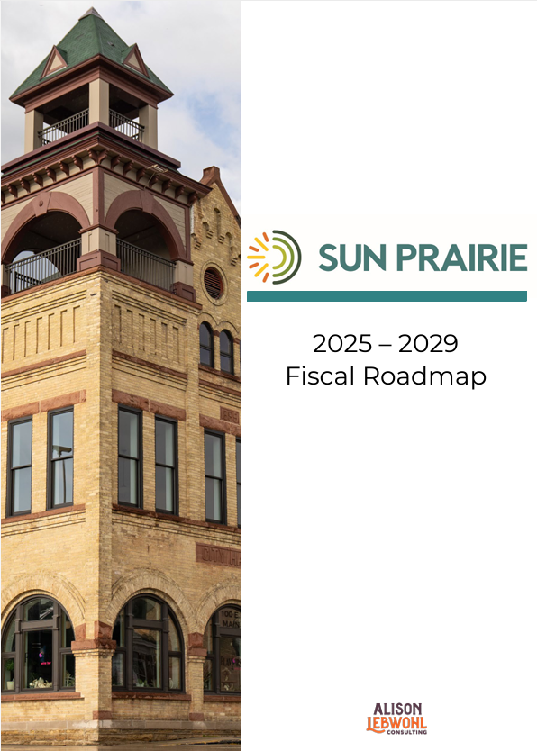
2027 and Beyond – Fiscal Roadmap
In the summer of 2024, the Common Council participated in strategic planning sessions with the goal of creating a financial roadmap for the next 5 years, 2025-2029.
The city spent considerable time conducting public engagement in advance of the April 2026 referendum vote. The referendum included investments in public safety services while also maintaining the existing quality services and programs the community enjoys. The referendum was unsuccessful.
Council and staff are currently working towards alternatives to balance the 2027 budget with the least impact possible to services and staff as the city plans for the future and the next potential referendum.

Slide 33
Litigation and
Risk Management

Slide 34
Insurance Lines Carried
Liability coverage is through Cities and Villages Mutual Insurance Company ($50k SIR/$200k aggregate deductible)
Property coverage is through Municipal Property Insurance Company (successor to LGPIF)
General Liability
Auto Physical Damage
Auto Liability
Employment Practices Liability
Discrimination
Cybersecurity
Professional
Property

Slide 35
Cybersecurity Concerns
City undertakes regular cybersecurity audits
  Identify threats
  Plan for responses
Disaster recovery and business continuity plan
  Multiple offsite backup tape rotations
  Seven day immutable near-line backups
Dual authentication with implementation of single sign-on
Appropriate IT usage policies

Slide 36
Claims and Litigation Handling
Claims processed by internal claims committee with settlement authority
  Administration
  Finance
  Attorney
  Insurance company
Litigation tendered to insurance for defense
Tax assessment matters handled in-house until discovery

Slide 37
Pending Claims and Litigation
City has no outstanding litigation which could materially impact city finances
Pending matters
  Excessive tax assessments
  Drowning lawsuit
  Federal and state case from police defendant
  Federal case from former employee
  Explosion lawsuit
No unresolved claims exceeding $25,000

Slide 38
Pending Litigation – Tax Assessments
Walgreens
  2025 tax year
  Currently in litigation, settlement discussions continue
Menard's
  2023-2024 tax years
  Currently in litigation, settlement discussions continue
  Discovery complete
  Court trial scheduled for November 2026

Slide 39
Pending Litigation – Liability Claims
Lawsuit from estates of Legend Sims and Antwon Amos Jr.
  Stormwater pond drowning deaths
  Currently in litigation, discovery phase
  City of Sun Prairie is now dismissed from case
Rose Daily federal lawsuit
  Complaint answered, discovery phase scheduled
2018 explosion lawsuit continues but city has been dismissed

Slide 40
Other Topics
Completed Natural Hazard Mitigation Plan
PFAS is not a significant concern for SPU
No privately placed debt or bank loans
Inflationary impacts absorbed with existing budgets or by altering project scope
Emergency Management
  Continuity of Government planning
  Incident Command
  FEMA and NIMS Training

Slide 41
Significant and Sustainable Community Growth
Investment in Community Planning
Sound Financial Management

