Slide 1
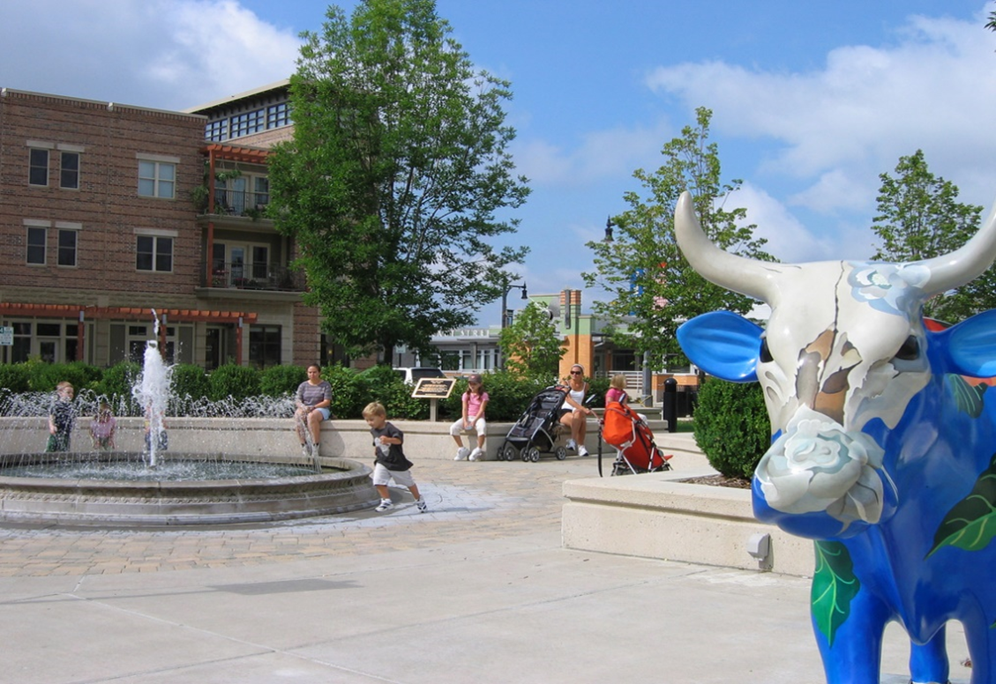

Presentation to Moody’s Investors Service
July 7, 2022

Slide 2
List of Attendees
City of Sun Prairie
  Aaron Oppenheimer, City Administrator
  Kristin Vander Kooi, Finance Director
  Rose Schulze, Finance Manager SPU
  Taylor Brown, Economic Development Director
Ehlers Public Finance Advisors
  Todd Taves
  Jon Cameron
Moody’s Investors Service
  Amy Hellmann

Slide 3
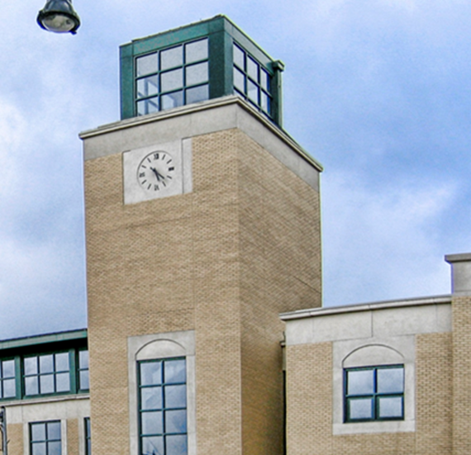
Agenda
Community Background
Economic Advantages
Largest Employers and Taxpayers
Historical Population and Tax Base Growth
Community Development
Financing Plan
Future Debt Forecast
Effects of COVID-19
City Financials

Slide 4
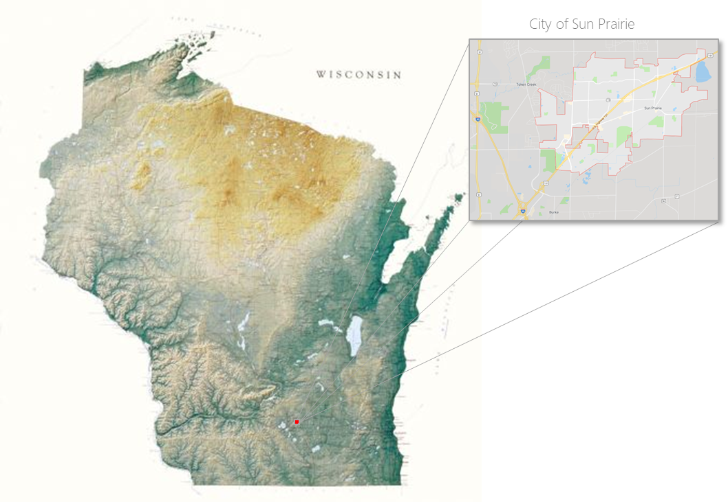
Community Background
Located in Dane County (Aaa), adjacent to the City of Madison (Aaa)
Approximately 13.1 square miles
One of the fastest growing cities in Wisconsin
Population estimate of 36,394
January 1, 2021 Equalized Value of $4,176,130,900 (TID IN)

Slide 5
Economic Advantages
Highly Desirable Dane County Location
  10 miles to the Dane County Regional Airport
  155 miles to Chicago
  75 miles to Milwaukee
  255 miles to the Twin Cities
  I-90, I-94, and STH 151 provide convenient access
  University of Wisconsin- Madison
  Express bus service
  Sun Prairie Area School District
Unemployment Rate (12/21 and 5/22)
  City of Sun Prairie 3.3%/2.3%
  State of Wisconsin 3.8%/2.9%
  United States 5.3%/3.4%
Per Return AGI (2021)
  City of Sun Prairie $39,514
  Dane County $44,687
  State of Wisconsin $34,913

Slide 6
Largest Employers
Many major employers have undergone physical expansions or renovations as responses to growing needs.
  Royle Printing
  Axim Geospatial
  Milwaukee Tool
City of Sun Prairie added 8 new employees in 2022
Sun Prairie School District projects increase in student enrollment
Sun Prairie School District, City of Sun Prairie, and Sun Prairie Chamber of Commerce continue to build a joint relationship to help aid businesses in filling the pipeline from students to employees.

Slide 7
Largest Taxpayers
Hilton Garden Inn (Iowa Machine Shed) dropped out of the top 5 taxpayers due to a 2020 appeal/settlement
Two apartment owners entered the top ten taxpayers
Tallamore Senior Living (new construction) enters top 15 taxpayers
No significant change to top two taxpayers
  Fedler/Connery
  General Casualty
Only excessive assessment claim outstanding is Walmart

Slide 8
Historical Population Growth
Population increased 22.0% between 2012 and 2021. From 29,840 to 36,394.
Average annual population increase since 2012 has been 696.
Annual population growth of 800-1,000 persons per year projected.
Growing at a pace to reach 50,000 by 2030.

Slide 9
Historical Tax Base Growth
Equalized value increased 75.50% between 2012 and 2021. From $2.354 billion to $4.176 billion.
Projected growth in Equalized Value of 1.31% annually.

Slide 10
Tax Base Growth
Real Estate values increased $310 million (8.12%) in 2021
  6.2% increase due to appreciation
  3.0% increase due to residential improved new construction
Commercial improved new construction increased 4.8%
Increase of 7.2% due to an improved commercial correction
  Without the correction, overall increase would have been 6.52%

Slide 11
Equalized Value by Property Class (2021)

Slide 12
Community Development
Sun Prairie Strategic Work Plan
Central Main Street Corridor Plan
Comprehensive Plan (updated 2019)
Parks and Open Space Plan
Sun Prairie Stronger Plan
10-Year Capital Improvement Plan
5-Year Financial Management Plan
Creation and Expansion of Tax Incremental Districts
New Residential and Commercial Development Areas

Slide 13
Community Development (cont.)
Residential Development Areas
Smith’s Crossing- multiple phases
Meadow Crossing- multiple phases
West Prairie Village- multiple phases
Multi-family apartment complexes (Roers, Gorman, Cascade, Landing)
Mixed-use buildings which accommodate a variety of housing types as well as commercial/retail areas
67 One/Two Family Home permits issues through June

Slide 14
Community Development (cont.)
Commercial Development Areas
Park 151 construction of Commerce III and Commerce IV
  Tenants to be Trachte & Milwaukee Tool
Second Culvers at Ironwood/Hwy 19
Prairie Lakes fringe development of smaller buildings
Quarra Stone to start construction on world headquarters
Downtown redevelopment complete for Glass Nickle
Plans approved for Lokre development with commercial and multifamily units
Construction of the second high school is nearing completion

Slide 15
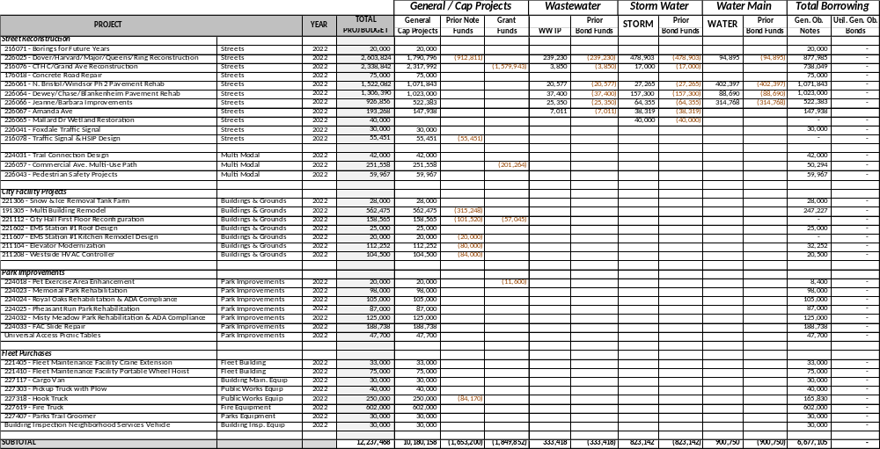
2022 Financing Plan

Slide 16
Future Debt Forecast
The City is anticipating to borrow $1,803,335 from the State Trust Fund Loan Program
  $1,675,335 for TID 12 infrastructure and incentive related a TIF agreement with Quarra Stone
  $128,000 for TID 13 incentive related to a TIF agreement with Park 151
No other future borrowing within the next 12 months

Slide 17
Effects of COVID-19
2020:
Reduction of revenues
Vacancy, Contractual, and Program Savings
Reduction of Training Budgets
Emergency Small Business Loan Fund
City Tourism grants
2021:
Kept expenditures level with 2020
Budgeted decrease in investment income and public accommodation tax
Funded all vacant positions
No use of fund balance to balance budget

Slide 18
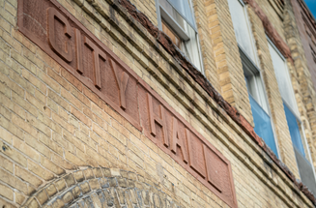
Effects of COVID-19 (cont.)
2022:
Continued reduction in investment income
All other revenues back to pre-COVID levels
Developed plan for use of ARPA funds
City buildings open to the public
No direct impacts on the local economy and tax base

Slide 19
2021 Audit
Revenues greater than budget by $248,228
  Licenses and Permits surplus of $253,506 due mainly to increased development within the City.
  Public Charges for Services surplus of $156,029 primarily due to increase ambulance fee revenue. This was offset by a decrease in Family Aquatic Center revenue from decreased attendance and the concession stand not opening in 2021.
  Investment Income deficit of $95,072 due to continued decreasing interest rates

Slide 20
2021 Audit (cont.)
Expenses less than budget by $1,110,913
  Police Department surplus of $264,845 due to retirements and change of career vacancies
  General Government Operations surplus of $481,037 primarily due to vacancy savings and unspent contingency
  Public Works Department surplus of $165,423 due to savings in roadway salt from a mild winter
  Culture, Recreation, and Education surplus of $95,370 primarily due to not opening the concession stand at the Family Aquatic Center
  Conservation and Development surplus of $142,527 due to change of career vacancies

Slide 21
Fund Balance
Total General Fund Balance: $13.7 million (net increase of $150,800)
  Non-spendable fund balance $3.4 million
  Restricted fund balance $.7 million
  Assigned fund balance $3.7 million
  Unassigned fund balance $5.8 million
Unassigned fund balance 23.6% of prior year general fund revenue budget
  Fund balance policy: 16%-20% of prior year general fund revenues
  Creating a plan to bring fund balance back into policy

Slide 22
TID Advances
TID 8 currently has an advance of $875,000. This is a decrease of $987,000 from 2020.
TID 11 currently has an advance of $15,705. This is a decrease of $173,279 from 2020.
TID 12 currently has an advance of $766,538. This is an increase of $313,874 from 2020.
TID 13 currently has an advance of $590,228. This is a decrease of $294,979 from 2020.

Slide 23
2022 Budget: General Fund
Planned breaking of expenditure restraint
  Brought Library and Recreation funds back into the General Fund
  Flow through of budgeted ARPA funds into the General Fund
    Grant Administrator
    Equity Audit
    Police Department Social Worker
  Flow through of Expenditure Restraint grant monies
$935,018 of fund balance applied. Increase over 2021 due to:
  $115,000 IT Replacement Fund to Capital Projects Fund
  $324,700 Library fund balance for capital campaign and IT replacement needs
  $40,000 Building Maintenance fund balance for tables and chairs

Slide 24
Enterprise Funds
Public charges for services continues to be leading source of revenue
All utilities realized an increase in net position, primarily due to the development within the City.
Rate Increases:
  Water December 31, 2021
  Electric October 1, 2019
  Wastewater January 1, 2022
  Stormwater February 25, 2020
Stormwater and Wastewater rate cases are conducted every 2-3 years
Sun Prairie Utilities Commission provides approval to apply for rate increases to the PSC

Slide 25
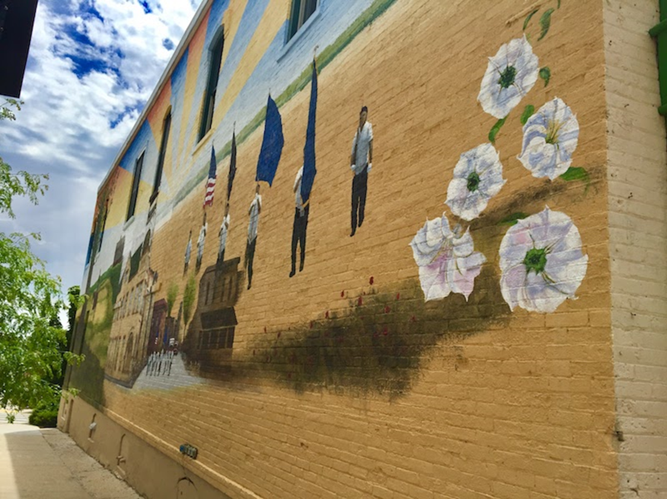
Summary
Significant and Sustainable Community Growth
Investment in Community Planning
Sound Financial Management

